Slide 1
Classifying Stellar Spectra
By Edith Johnston
Notes:
So without further ado, today I’ll be walking you through the project I did on classifying stellar spectra!

Slide 2
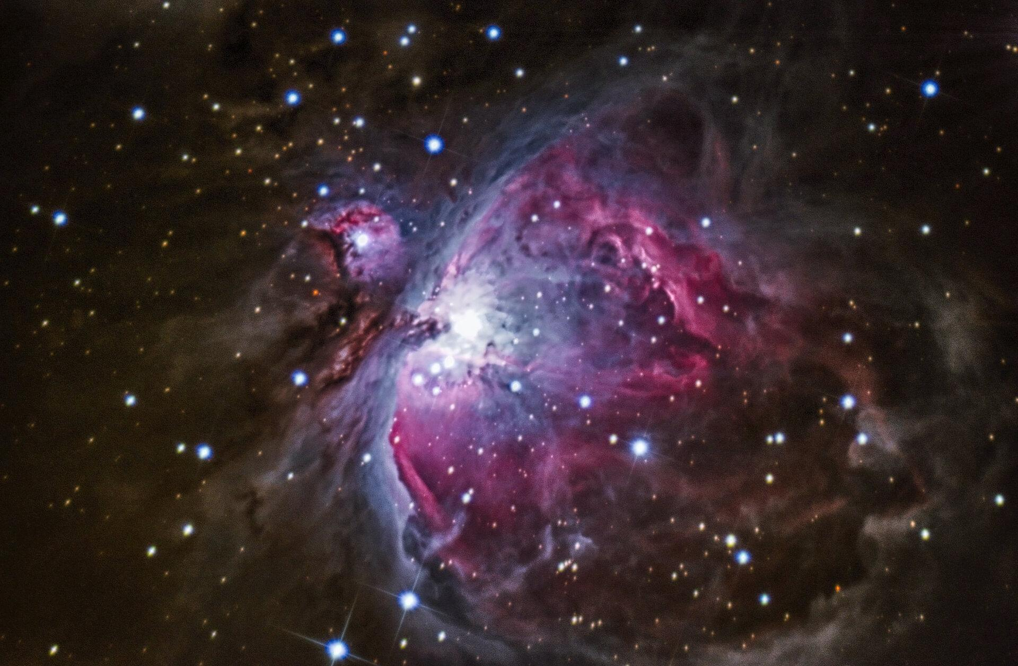
Table of Contents
Science Intro
Data and Model
Model Performance
Next Steps
Notes:
Before getting into the project details, I want to briefly overview the science of this project
First, the target class I was attempting to predict is what’s called Morgan-Keenan spectral types, which look a little something like this >>>

Slide 3
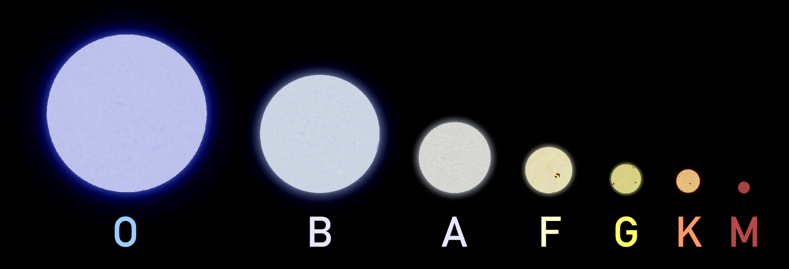
Stellar Spectral Types
Our Sun
Notes:
These spectral types are essentially a means to group stars with similar characteristics such as mass and temperature
These characteristics strongly affect color - think about how a candle flame is blue in the center, at the hottest part
So in order to determine type, astronomers look at… >>>

Slide 4
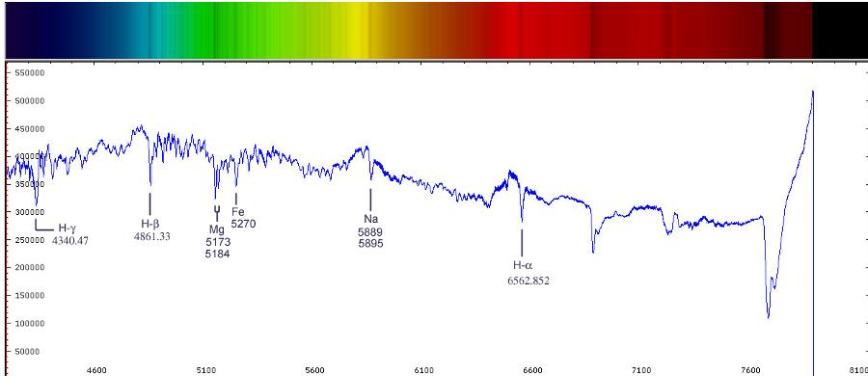
Stellar Spectra
Notes:
...the spectrum of visible light coming from by star as in this colored bar here
Then they record the intensity of light according to wavelength, which looks like this >>>
For this project, I acquired data from the Sloan Digital Sky Survey Server, which consisted of estimates of this intensity at a series of specific line indices >>>

Slide 5
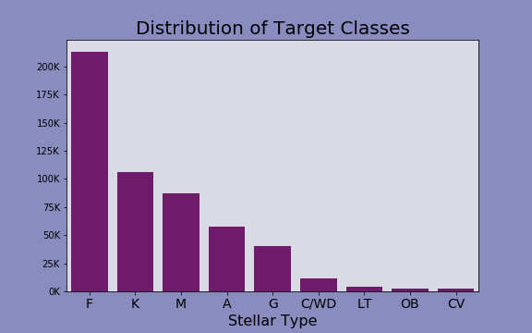
Class Distribution
Tools used: Imblearn, Sci-kit learn, SciServer, Pandas
Largest 5 Classes: Random Undersampling
Smallest 4 Classes: Random Oversampling
Notes:
After acquiring additional information on the stellar type of the stars in my dataset, I had nine different classification categories
However >>> these classes were super imbalanced!
The largest class had over 200,000 samples, while the smallest had only 1/100th of that
To correct this I ended up doing two things: >>>
1st, I undersampled large classes >>>
then oversampled small classes to get a uniform quantity of 10k samples for every class.
I chose to take this combined approach to try and avoid either reducing my dataset down too far, or generating massive quantities of repeated or artificial data

Slide 6
Model
Histogram-based
Gradient Boosting
Classification Tree
Advantages of This Model:
Scales well to more features
Faster for large sample sizes
Missing value handling
Notes:
Going into the modeling process, I tested a number of models
After extensive testing and evaluation, I landed on the histogram-based gradient boosting model >>>
There’s a few reasons this model was attractive to me.
For one, it scales really well to large numbers of features. Given that my data had 340 feature columns, this was very helpful to me. >>>
Similarly,, because of the histogram binning, this model also tends to be faster than other similar tree based ensemble models, such as XGBoost, especially when dealing with large sample and feature sizes.
Another big draw of this model for me was the treatment of missing values. A lot of the missing values in my data represented data points on the spectrographs too noisy or varying to accurately determine, so I wanted to implement a model that could find meaning from the presence of missing values without having to change the shape of the data by interpolating or removing them. This model did that for me, as it essentially treats them as a categorical variable integrated with the continuous features. >>>
In the end, this model outperformed every other model I tried >>>

Slide 7
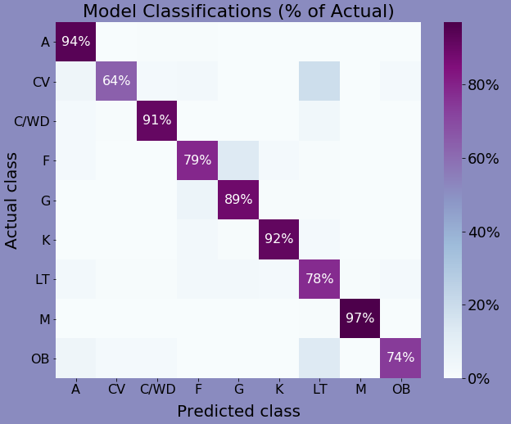
Model
Performance
Balanced accuracy score:
0.84
Tools used: Pandas, Sci-kit learn, SciServer, XGBoost
Minority classes
Correct classifications are on the diagonal
Hist-Gradient Boosted
Notes:
Speaking of performance, I used a couple of metrics to determine model success. My goal was basically to get the best accuracy rate I could for each and every class, so when I needed a single score metric, >>> I used balanced accuracy score. Since that’s an unweighted mean of class accuracies, it places more value on accuracy across all classes rather than across all samples, thus compensating for class imbalance.
However, I have a lot of classes and I was wary of using a single number to represent them all. Even with the metric compensating somewhat for imbalance, really good scores in majority classes will still sometimes cover up poorer scores in minority classes.
So to get more detail, through the modelling process, I mapped the confusion matrix normalized by true class. >>>
With the correct classifications on the diagonal, this plot makes it pretty easy to see at a glance how well the model performed for each class >>>
As you can see, for the most part this model did as well for my minority classes as it did for the others.
However, there was one more model type I wanted to try out

Slide 8
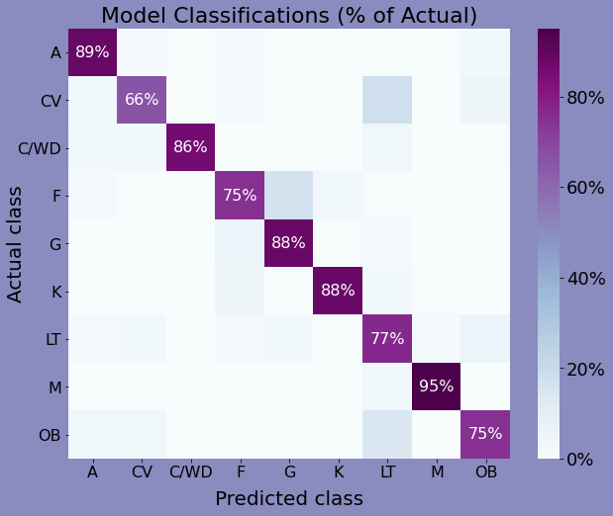
Neural Net Model
Balanced accuracy
score:
0.83
Tools used: Tensorflow, Sci-kit learn, Pandas, Google Colab
Minority classes
Correct classifications are on the diagonal
Notes:
This model doesn’t need to be interpretable, and the data itself is all numeric, and consists of a significant number of features, so I decided to try creating and fitting a neural net model.
I was surprised that not only was neural net was both significantly faster to train HGB, but also that this particular neural net model required comparatively much less hyper parameter tuning than HGB to achieve similar levels of success
Although I consider both of these models to be pretty decent starting points, there’s a lot more work I’d like to do on this project >>>

Slide 9
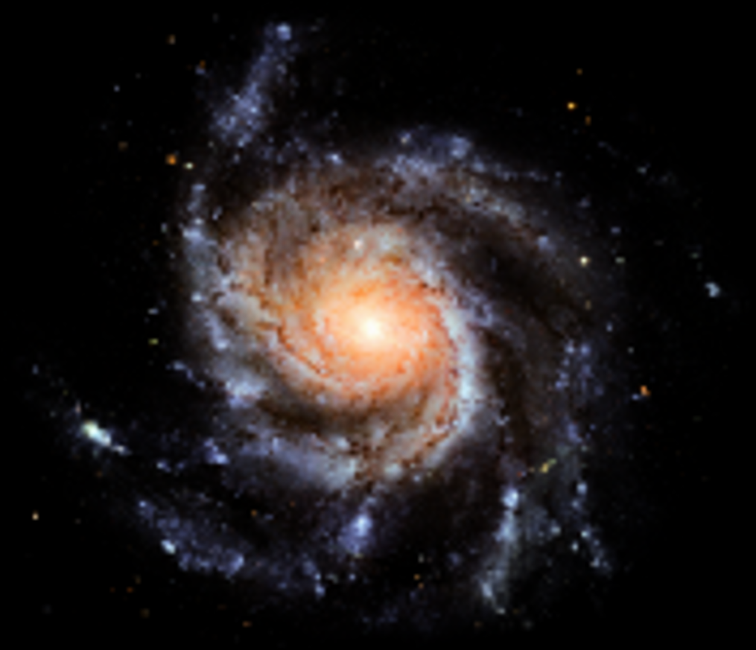
Next Steps
Adding Capability
Improving Performance
Subclasses
Non-stellar objects
Galaxies
Quasars
Cross reference other sources
Train iteratively with resampled data
Notes:
To start with, I would like to expand capability >>>
By dividing stellar types into subclasses, which are >>>
and adding in non stellar objects >>>
such as galaxies, >>> quasars, and more >>>
Additionally, I would like to improve performance and validity of my model in a couple ways >>>
One, by branching out my training data sources for the class labels - i want to make sure that I’m not incorporating someone else’s errors into my model>>>
And two, since I took a significant subsample of my data, I would like to iteratively retrain the model on different random states of under and oversampling to get a more thorough view of the data. >>>

Slide 10
Thank You
For Your Time
Project by: Edith Johnston
Github: https://github.com/edithalice
LinkedIn: www.linkedin.com/in/edith-johnston
Notes:
And with that, thank you very much for your time and attention and i hope you have a wonderful day

Slide 11
The Fine Print
This research makes use of the SciServer science platform (www.sciserver.org).
SciServer is a collaborative research environment for large-scale data-driven science. It is being developed at, and administered by, the Institute for Data Intensive Engineering and Science at Johns Hopkins University. SciServer is funded by the National Science Foundation through the Data Infrastructure Building Blocks (DIBBs) program and others, as well as by the Alfred P. Sloan Foundation and the Gordon and Betty Moore Foundation.

Slide 12
Appendix

Slide 13
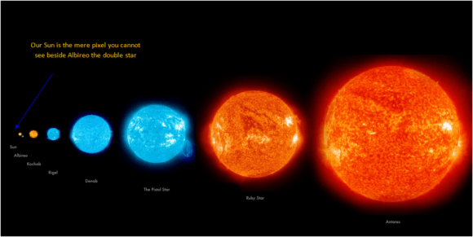
What’s the Point of Classifying?
Different behavior
Filtering searches
Potentially habitable planets can be found orbiting F or G stars
My Project Goal
Too many stars!
⇩
Automation
Notes:
What’s the point? Well one big reason is that >>>
Different types lead different lives and behave differently
A large blue O type star might live less than 10 thousand years and then implode into a black hole, whereas an M type red dwarf might last trillions of years before slowly dying out >>>
Additionally, stellar type makes a good filter when searching for stars that meet specific criteria
For example, if you’re looking for habitable planets >>>
Look at F and G stars
However
Given that astronomers determine stellar type by looking at spectra, why model it? >>>
Well the trouble is, >>>
there’s as much data as there are stars in the sky, and there’s just not enough time to classify them all manually
So >>> >>> i want to automate the process.

Slide 14
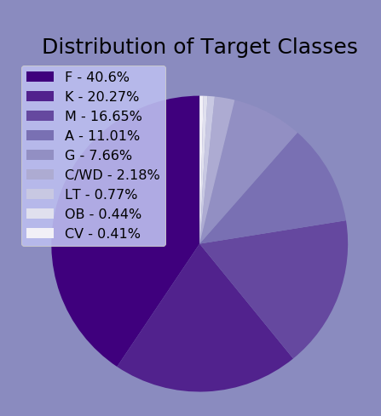
Data Structure
Features
Target
Data Source:
Sloan Digital Sky Survey
71 features with 4 sub features each
Each feature represent elemental line index
Sub features: global continuum fit, local value fit, error, pixel quality mask
Initially, 21 classes
After grouping by subclass, only 9 classes
Highly imbalanced: 5 of the 9 classes contain >96% of samples

Slide 15
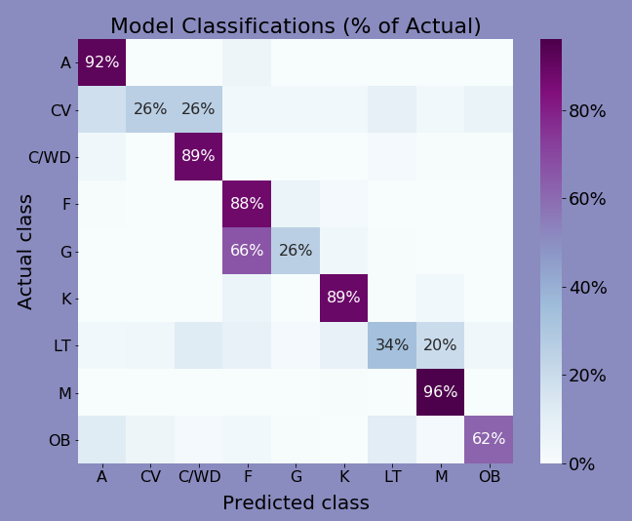
Model
For Comparison:
Decision Tree
Balanced accuracy
score:
0.67
Minority classes
Correct classifications are on the diagonal
Notes:
Some models for comparison

Slide 16
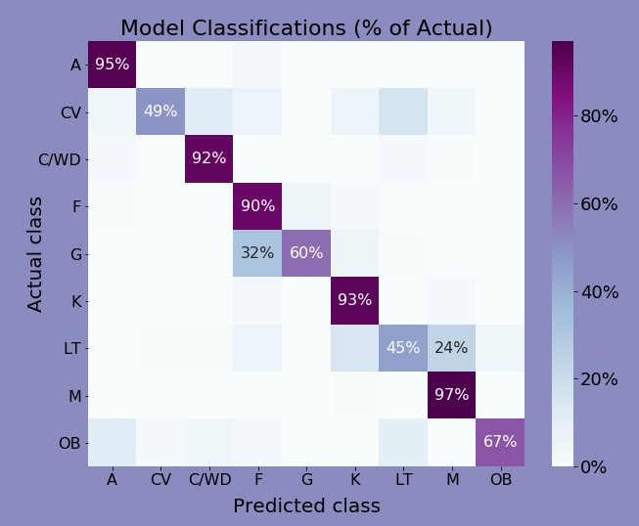
Model
For Comparison:
Random Forest
Balanced accuracy
score:
0.77
Minority classes
Correct classifications are on the diagonal
Notes:
Some models for comparison

Slide 17
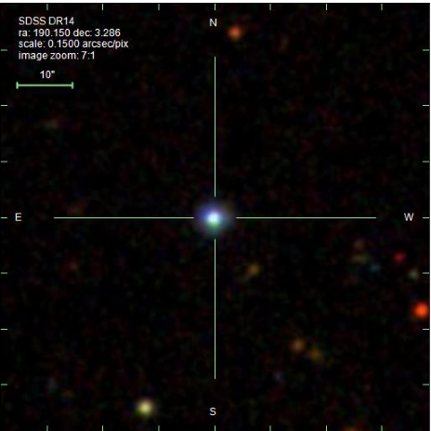
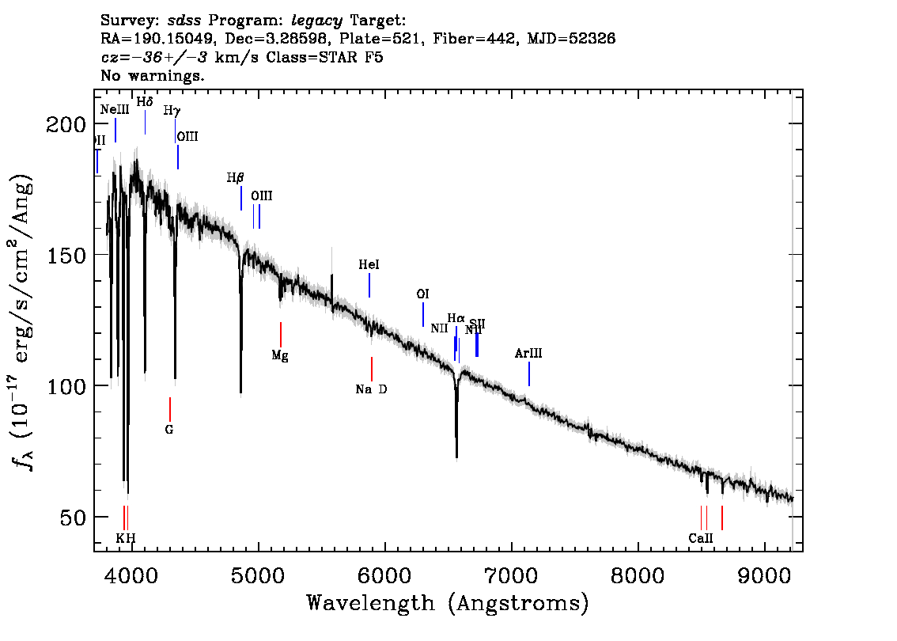
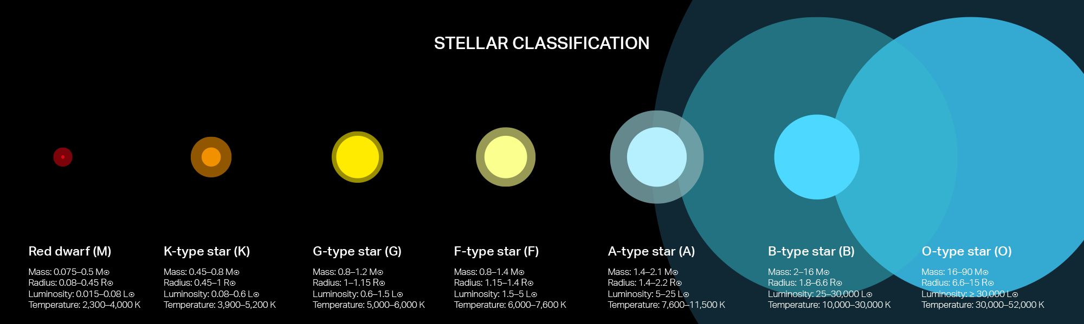
Sample Pipeline
Notes:
Let’s say we have this star
Take spectrum measuring across wavelengths
Measure intensity at specific line indices corr to elements
Feed into model to determine type

Slide 18
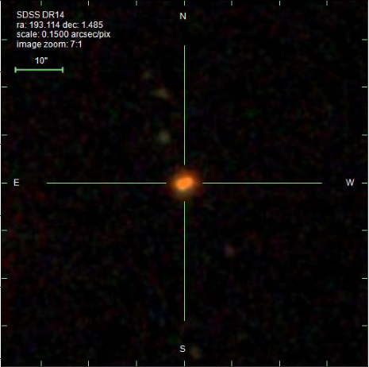
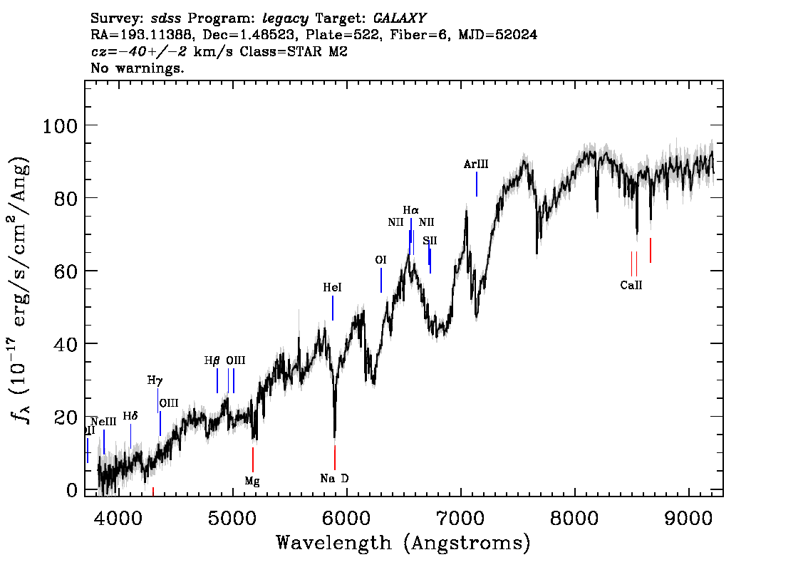
Sample Pipeline 2

Slide 19
More of the Science

Slide 20
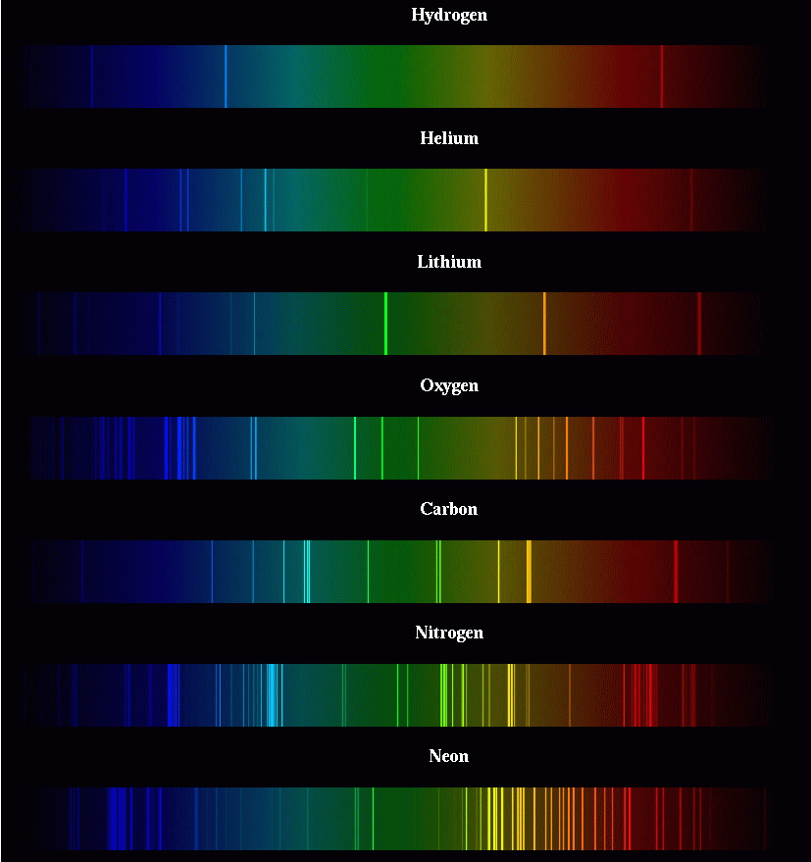
Spectrography
Different elements absorb and emit different wavelengths of light
Therefore we can determine presence of elements by looking for absorption lines (dark lines) and emission lines (bright lines)
Notes:
Pic 1: Normal stellar spectral types, pic 2: abnormal stellar spectral types, pic 3: elemental spectra, pic 4: stellar spectra

Slide 21
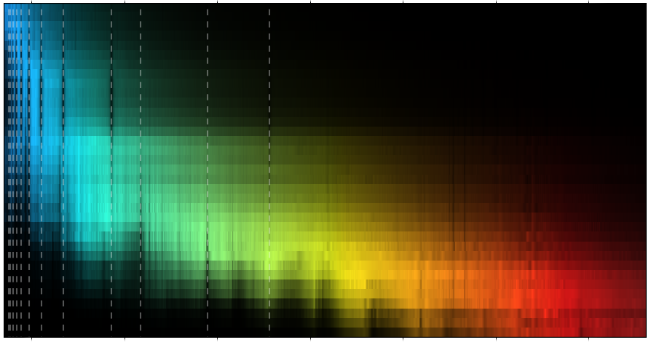
Spectrography
O
B
A
F
G
K
M
A bunch of different stellar spectra, ranging from Type O to Type M.
The different elements in these stars are causing lots of little lines.
Notes:
Pic 1: Normal stellar spectral types, pic 2: abnormal stellar spectral types, pic 3: elemental spectra, pic 4: stellar spectra

Slide 22
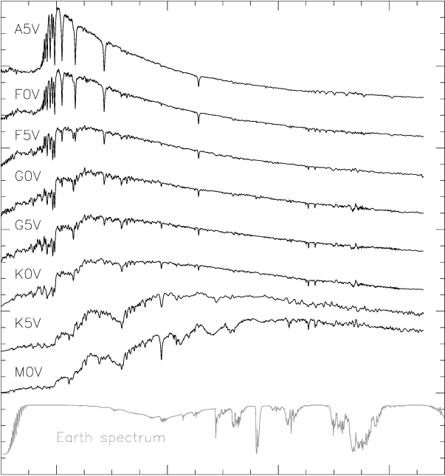
Spectrographs
These spectrographs can also be represented as graphs like these.
Those absorptions and emission lines now show up as sharp spikes or dips on the graph.
The surface temperature of the star can be determined from these graphs by looking at highest peak.
Notes:
Pic 1: Normal stellar spectral types, pic 2: abnormal stellar spectral types, pic 3: elemental spectra, pic 4: stellar spectra

Slide 23
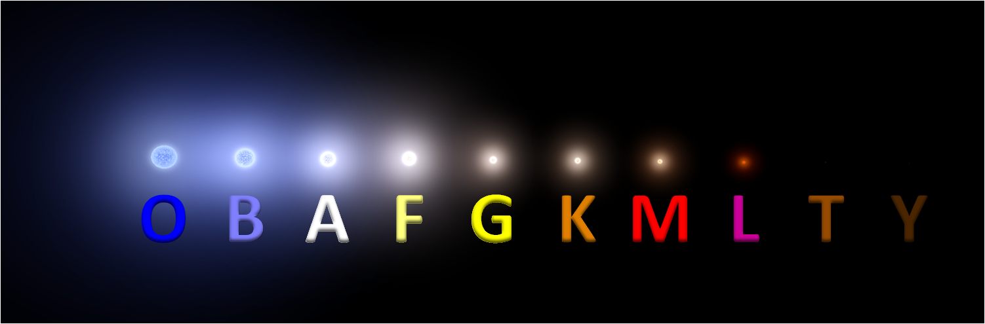
Spectral Types
Normal spectral types range from blue hypergiants in Type O to brown dwarfs in Y (which emit almost no light).
The Normal Ones

Slide 24
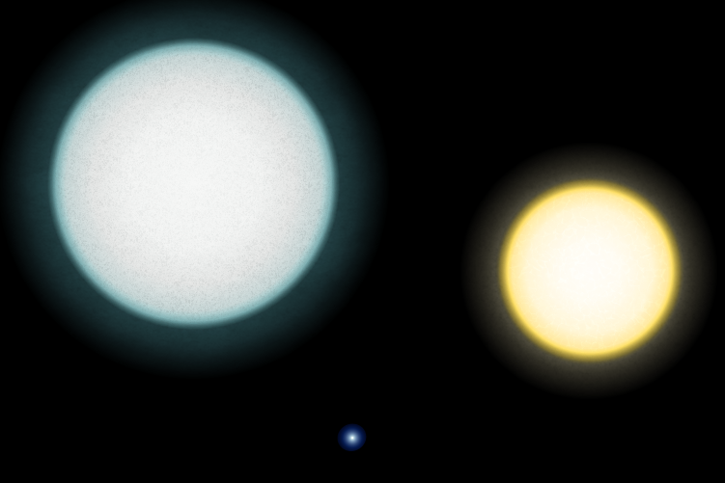
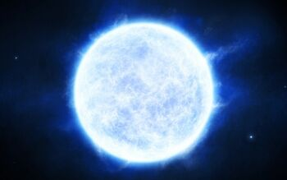
Spectral Types
But there are also abnormal spectral types, such as white dwarfs, relatively bright but very small stars
Usually these are the core of a larger star that has blown off its outer layers in a supernova
The Itsy Bitsy Ones
White Dwarf
Our
Sun

Slide 25
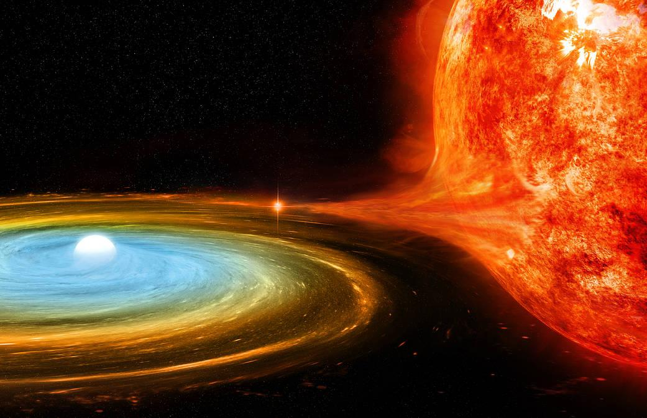
Spectral Types
Cataclysmic variable stars are a type of star that fluctuates in brightness over time. These stars only appear in binary systems
The Thieves
CV stars siphon material off of their binary companion, periodically building up layers and then blowing them off in a bright flash
Cataclysmic Variable Stars

Slide 26
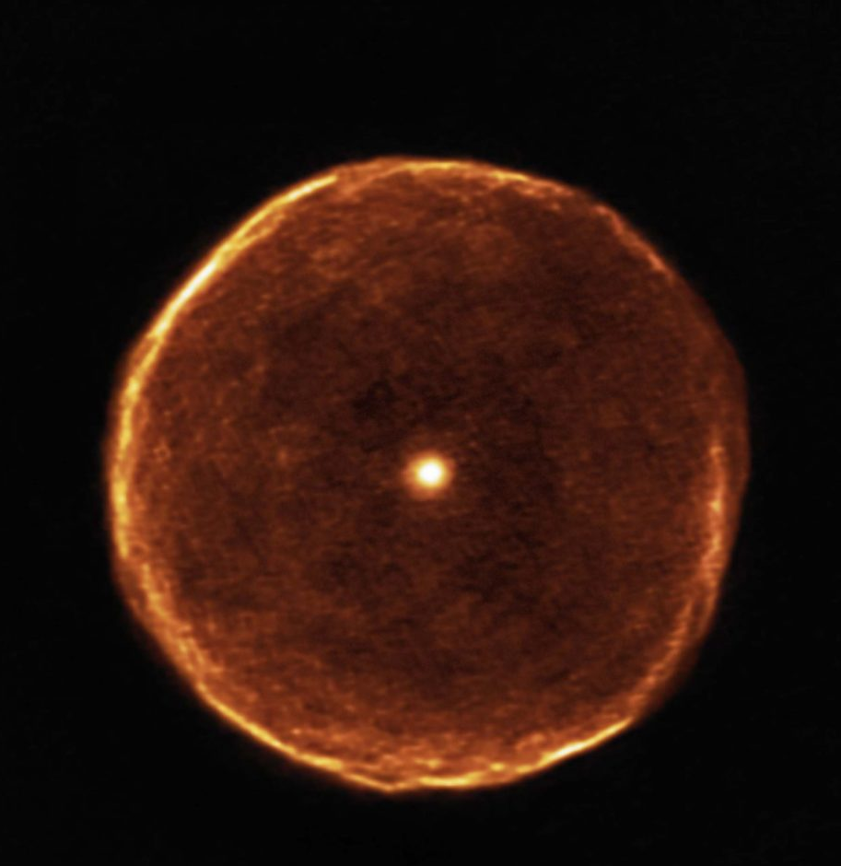
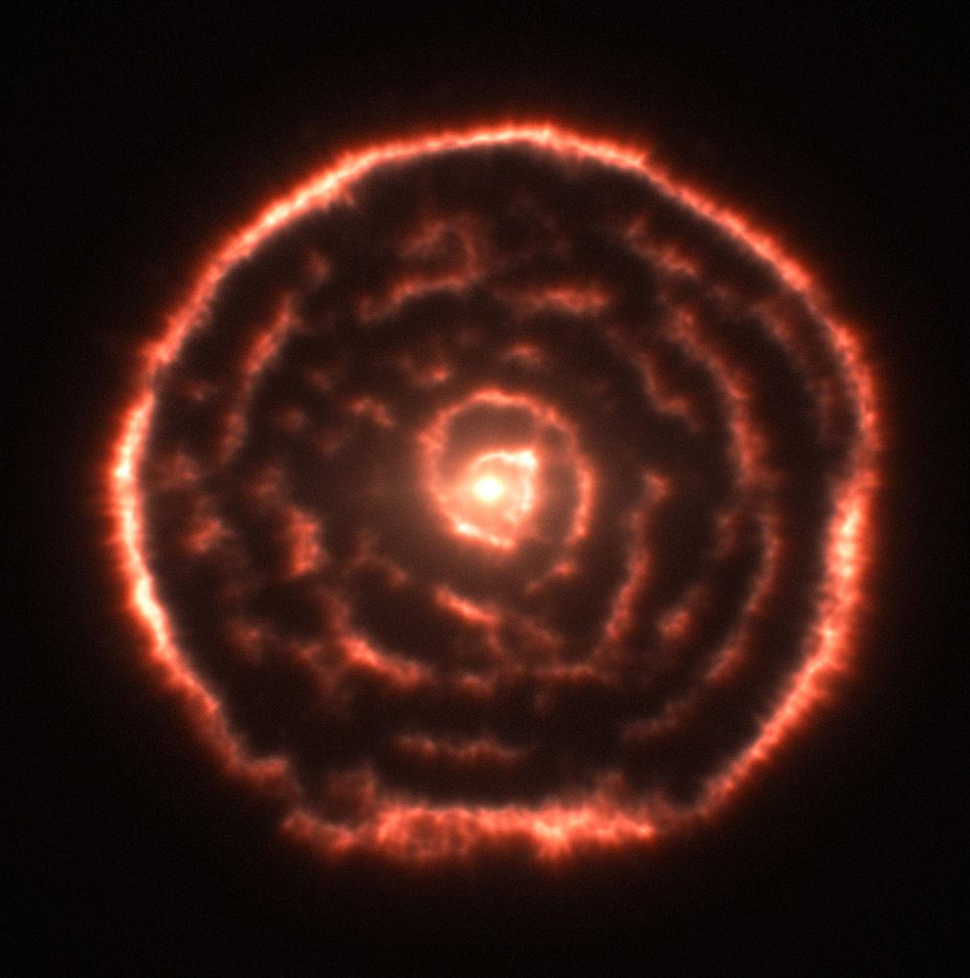
Spectral Types
The Dying Giants
Carbon Stars
Carbon stars are the faint remnants of late stage (dying) stars that didn’t have enough mass to supernova, so once fusion stops in the core, the outer layers gradually drift off

